Slide 1
MBA607A
Stage 2 - Jivan Care
GROUP 9-
Ayush Yadav (200256)
Vishnu Gaur (201132)
Divyansh Gupta (200351)
Sanskriti Sharma (200876)
Jayesh Lakade (200475)

Slide 2
Business Model
Our solution eyes Hospitals/Clinics as its target market segment.
Our business model aims to generate recurring revenues so that the organization is financially stable and can reach out to as many number of hospitals and people as possible.
We are using a fee-for-service business model.
Key Partnerships-Multi-speciality Hospital chains, Government ABHA plan

Slide 3
Cost Analysis
Prototype cost - Rs. 2900
MAX32664D+ IC - Rs. 435
ECG Module - Rs. 579
Temperature sensor - Rs. 533
Flex Sensor - Rs. 200
ESP32 WiFi Module - Rs. 168
Arduino Nano - Rs. 385
Battery -Rs. 100
Manufacturing cost - Rs. 500
TOTAL -Rs. 2900
Estimated Manufacturing cost (per device) -Rs.2000
Cloud Service Subscription (per device per month)- 2.58

Slide 4
Revenue Model
One time setup fee- Rs. 2000
Subscription Fees (per device) -
Daily- Rs. 5
Monthly - Rs. 90
Annual - Rs. 900
Patient Registration Fee - Rs. 50
Working Capital= 2 Crore*12= 24 Crore
Subtracting miscellaneous costs manufacturing costs= 20 Crore
Models Manufactured= 20 Crore/2000= 1Lakh models
90K models to Hospitals and 10K to Individuals
Each Model registers 10 people on average/ month
Total Revenue per year= 90000*120*50= 54 Crore

Slide 5
Stakeholders
Hospitals- Liabilities and death due to human negligence and improper monitoring will be reduced.
Nursing Staff - No longer require to check on all patient frequently
Patients & their Families - Patients' health will be monitored and discussed with their families on regular basis
Remote Patients - Patient's at home can rest assured that their vitals are being monitored continuously

Slide 6
Marketing Strategy
Building Brand Awareness
Health camps - Conduct health camps targeting doctors and medical professional to increase awareness
Healthcare Innovation Expos - Showcase our device in healthcare innovation symposium and expos to increase reach and scalability
Advertisement via Partner Hospitals - Advertisements via Hospitals availing our services as they can now advertise continuous monitoring of the patients
Offering Free Trial and Promotions
Hospital Visits - Demonstrate effectiveness in constant patient's care and reducing staff workload to encourage investment

Slide 7
Financing Plan
We plan to seek funding from a combination of sources, including our own personal investments, angel investors, and venture capital firms and PSU’s.
We are seeking Rs. 26 crore in initial funding, with the following breakdown:
Own Money- 1 crore
Family / Relatives- 1 crore
Equity -
Venture Capitalists(VC’s)- 18 Crore
Angel Investor- 5 Crore( 5% Equity of 100 Crore Valuation)
PSU’s- 1 Crore

Slide 8



Venture Capitalists(VC’s) and PSU’s
Aavishkaar - 3 Crore
4% Equity of 75 Crore Valuation
Bamboo Finance - 6 Crore
6% Equity of 100 Crore Valuation
Willgro - 3 Crore
4% Equity of 75 Crore Valuation

Slide 9




Acumen - 4 Crore
4% Equity of 100 Crore Valuation
CIIE - 2 Crore
2% Equity of 100 Crore Valuation
PSU’s
Hindustan Antibiotics
HLL Lifecare

Slide 10
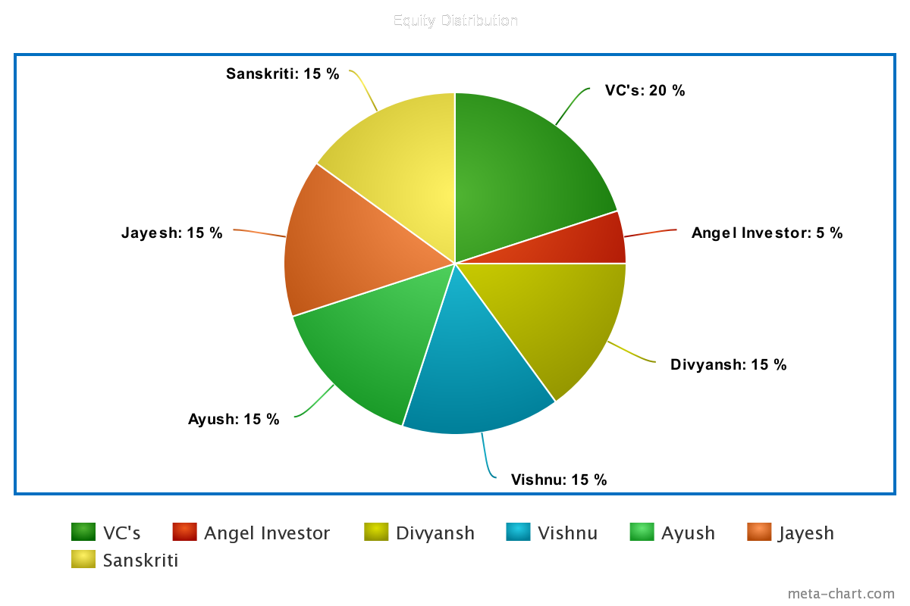
Equity Distribution

Slide 11
Pitchbook link
https://www.canva.com/design/DAFfikcUFsY/q-wDRJXAzfkIsYxyL6OE1A/edit?utm_content=DAFfikcUFsY&utm_campaign=designshare&utm_medium=link2&utm_source=sharebutton

